Slide 1
Autonomous Systems B Lab Precision Farming Electronic Engineering Winter Semester 21/22
Group 2
Fawad Murad
Muhammad Moaz Amin
Tunde Oluwayemi Aluko
Enkeledi Mema

Slide 2
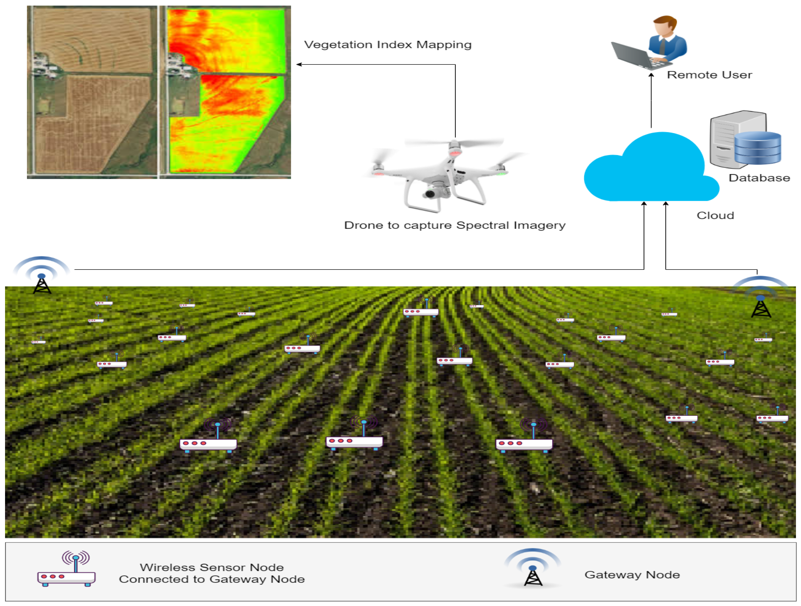
Motivation

Slide 3
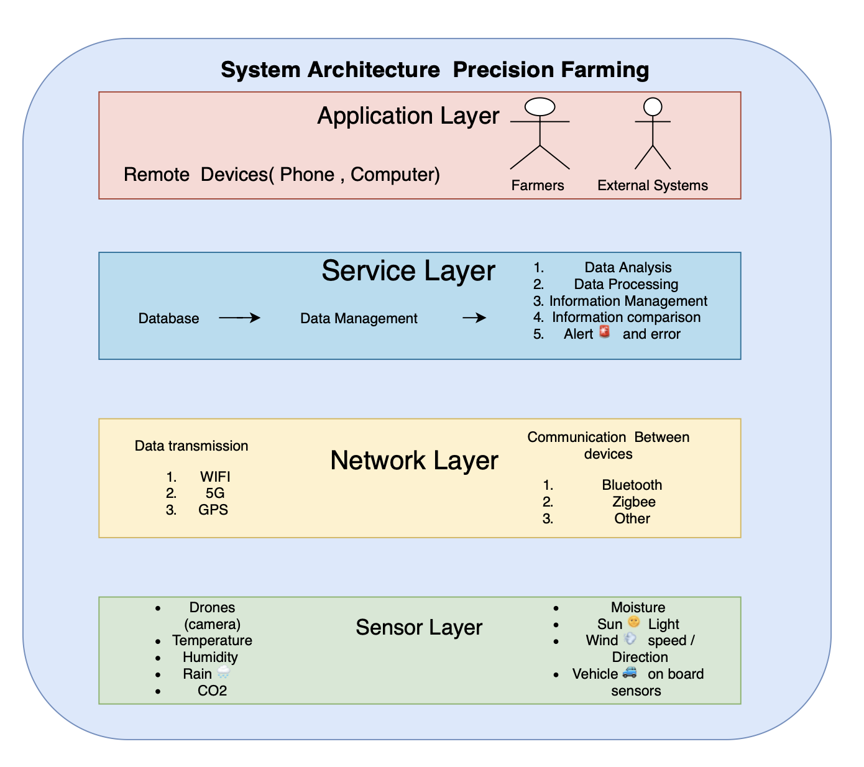
System Architecture

Slide 4
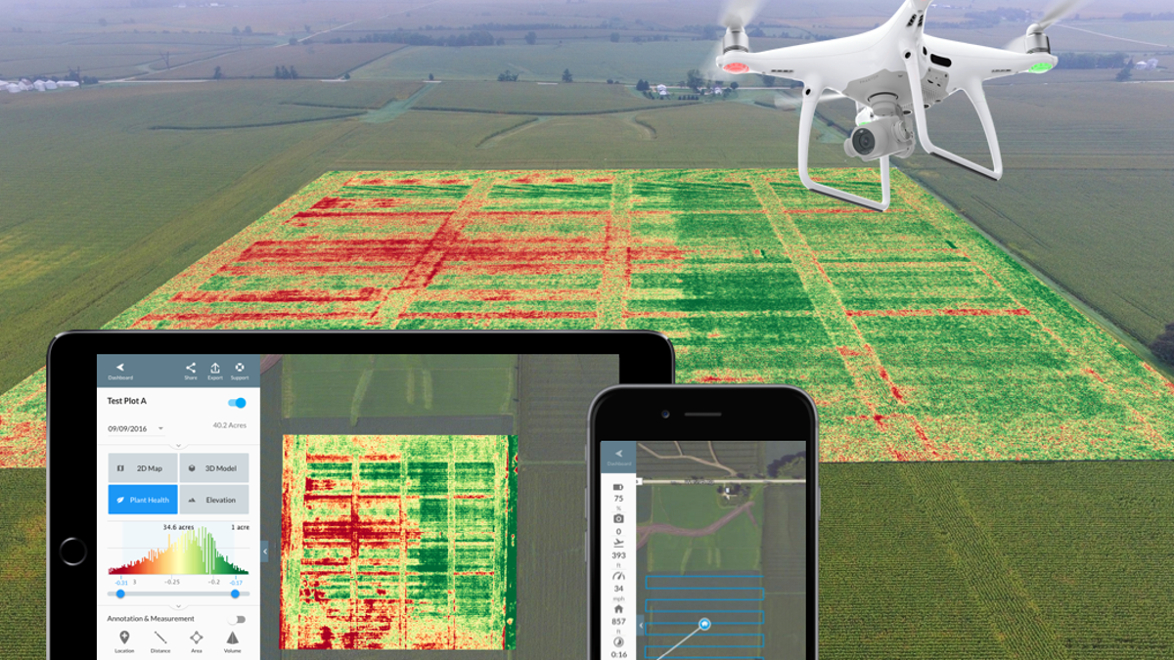
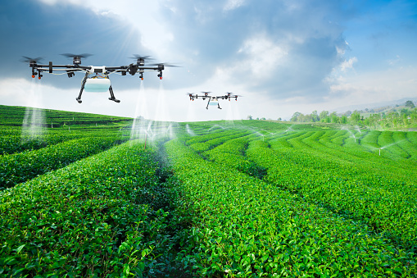
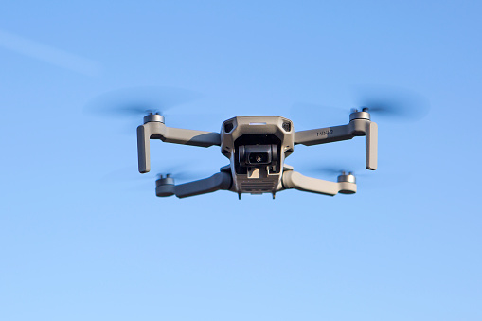
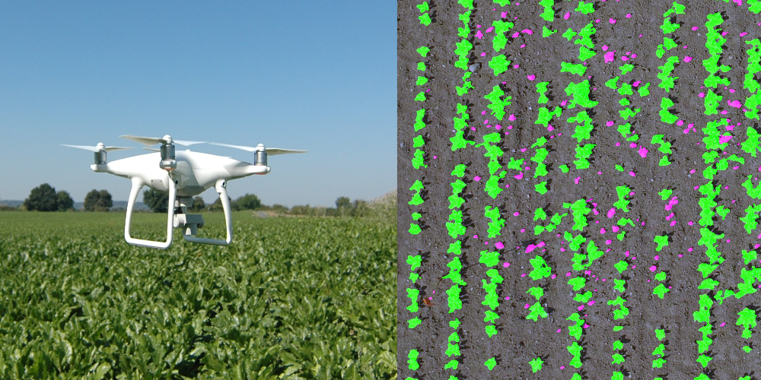
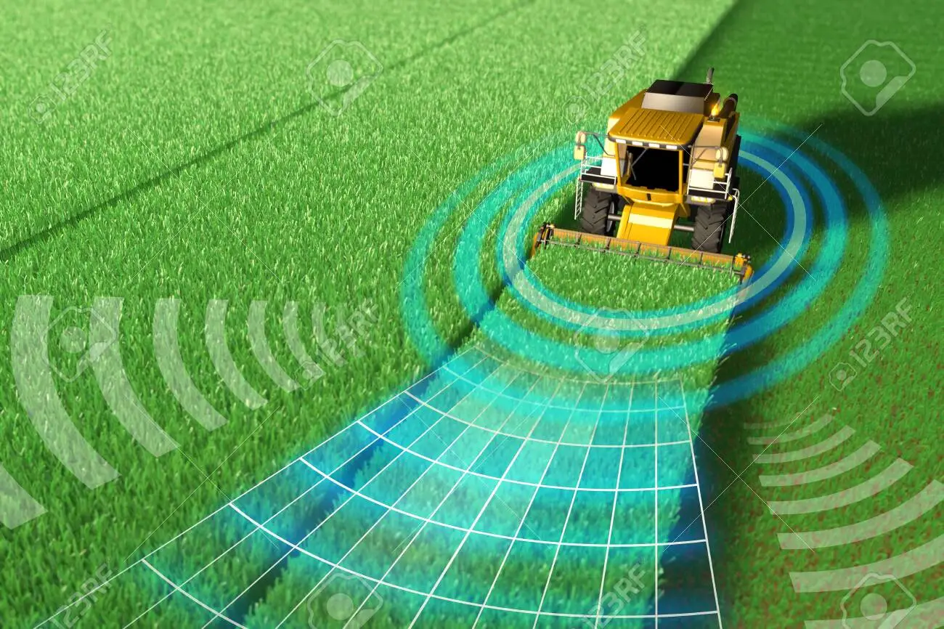
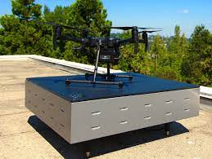
Mapping
Spraying
Drones
Detecting
Communicating
Charging Station

Slide 5
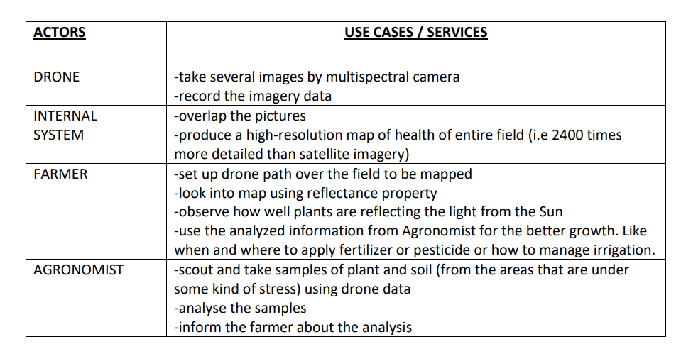
Use case specification for monitoring

Slide 6
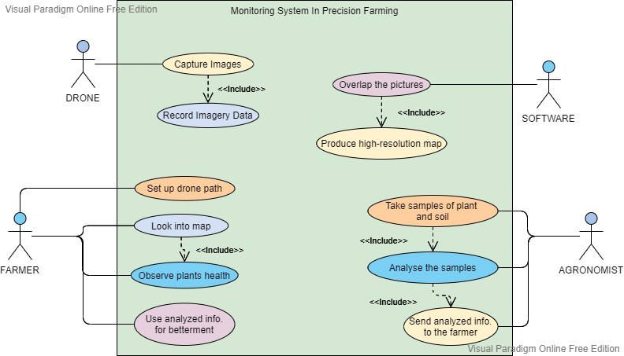
Use case diagram

Slide 7
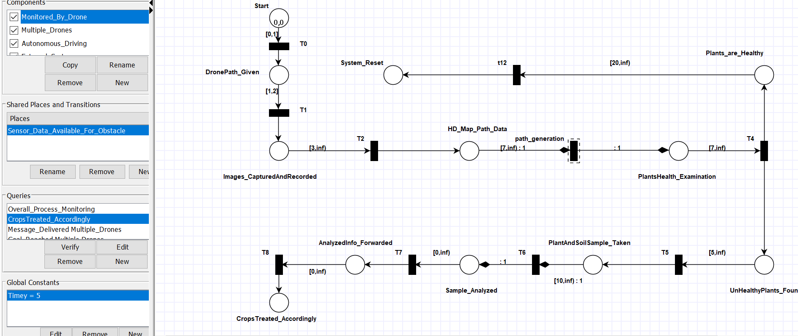
Modeling & Verifying the use case

Slide 8
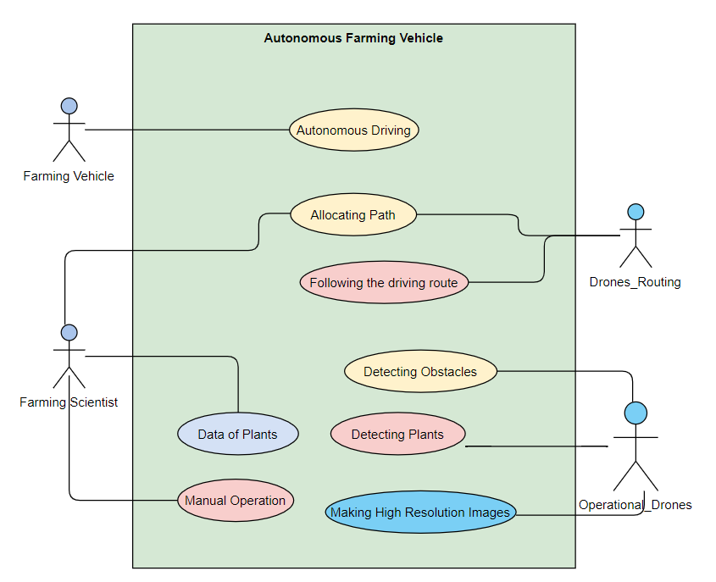
Use case diagram for autonomous systems
Allocating Path to Farming Vehicles
Obstacle Avoidance
Using High Resolution Map Data from drones
Avoidance maneuver by assessing which obstacle is present ( Sensor Data)
Harvest Operation

Slide 9
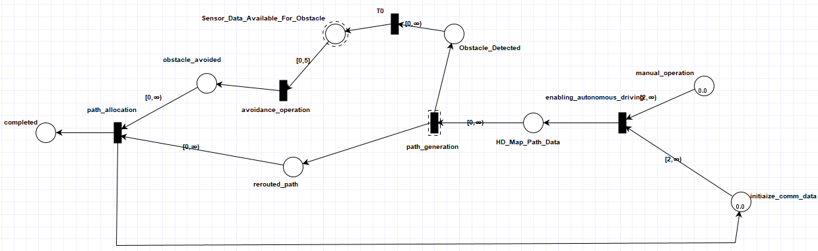
TAPAAL Implementation

Slide 10
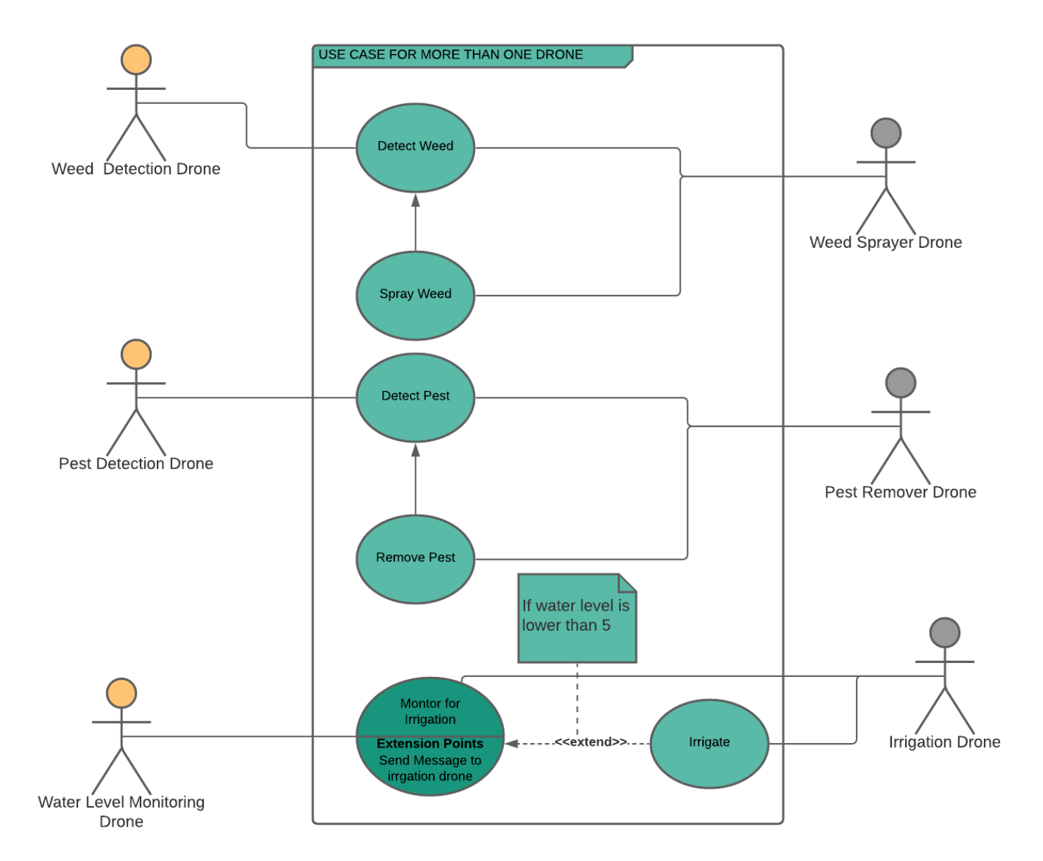
Use Case

Slide 11
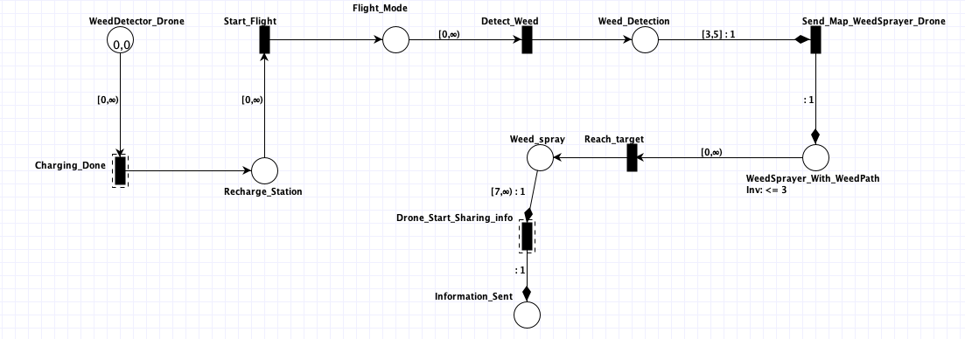
Modeling & Verifying the use case

Slide 12
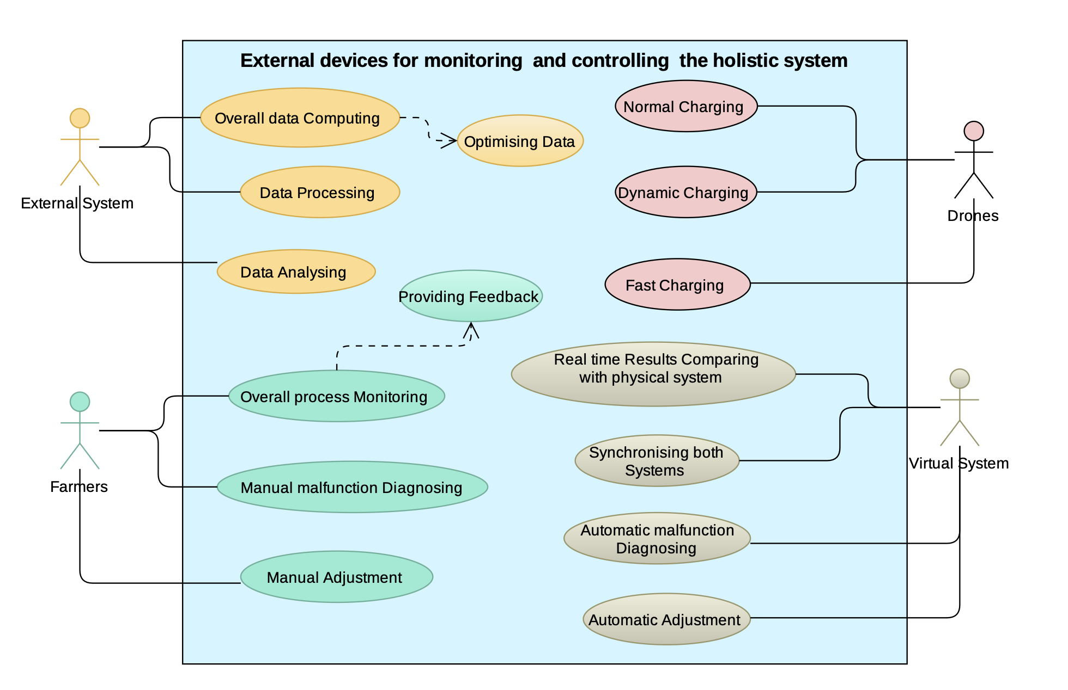
Use case External devices

Slide 13
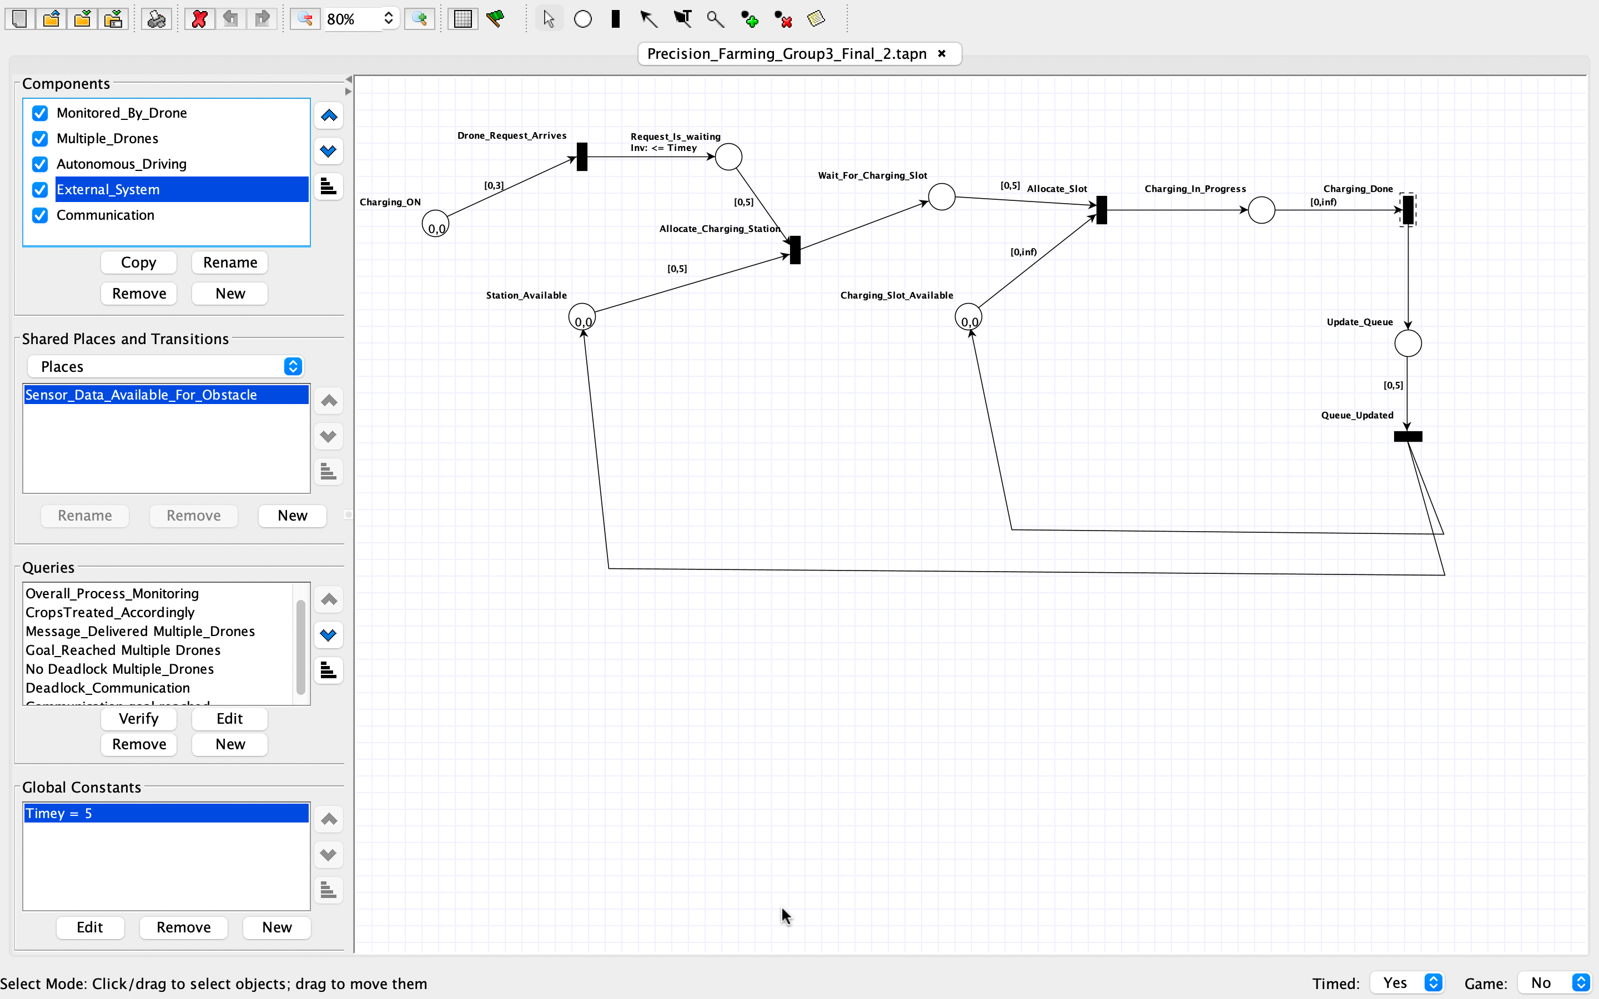
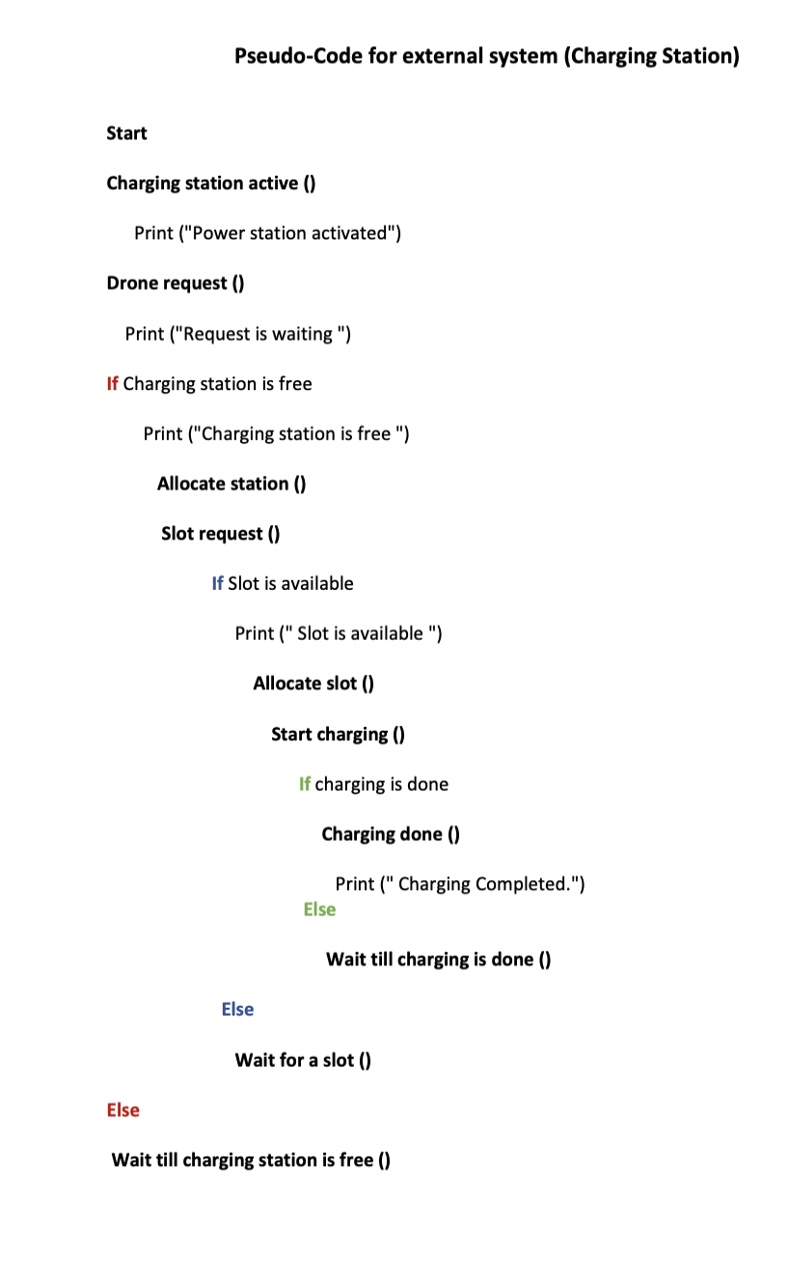
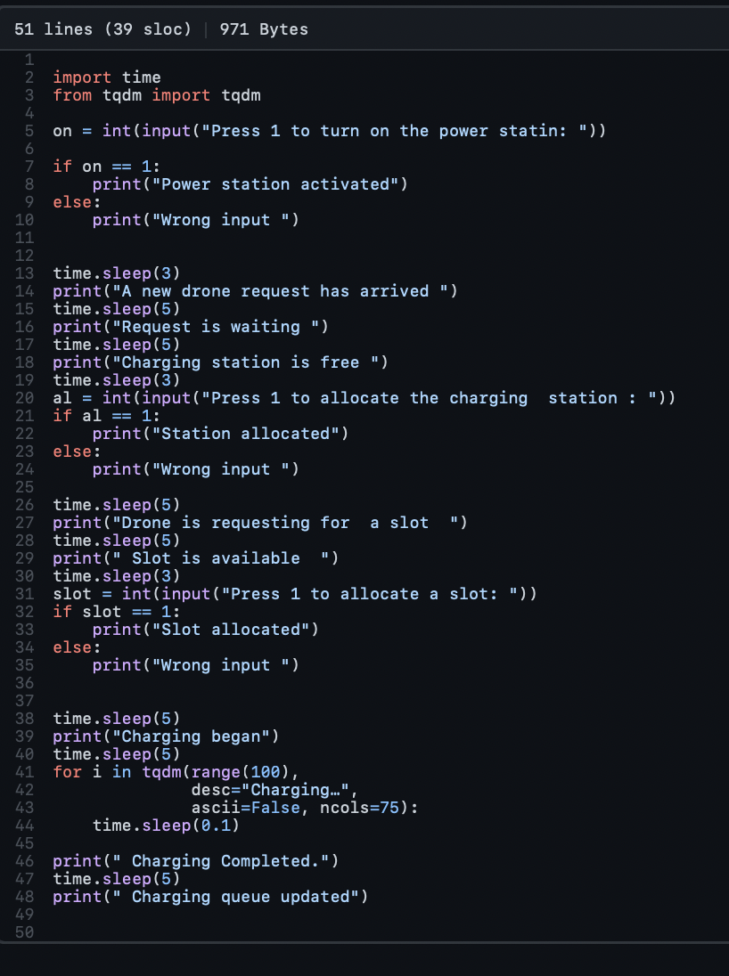
Modeling & Verifying the use case

